Slide 1
Essential Leadership Skills for Public Health Practitioners
Stephen J. Thomas, MD
Director, Institute for Global Health and Translational Sciences
Chair (interim), Microbiology & Immunology
SUNY Upstate Medical University
SEP 2021

Slide 2
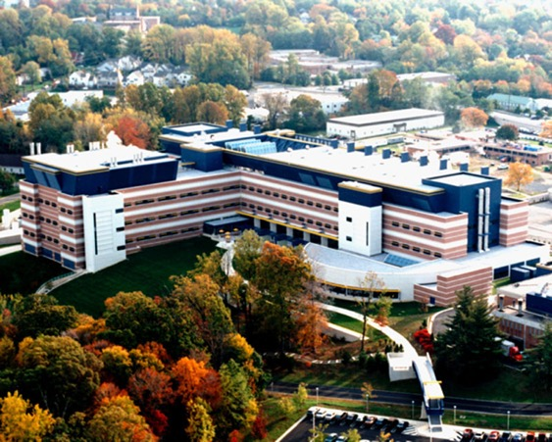
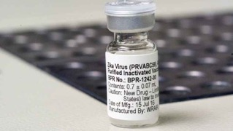
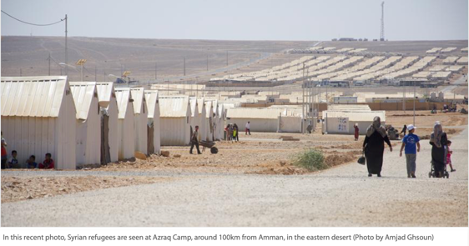
Leadership Perspective
US Army
1996-2016

Slide 3
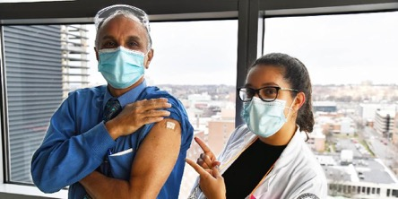
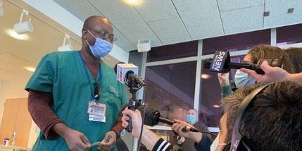
Leadership Perspective
Upstate
2016-today

Slide 4
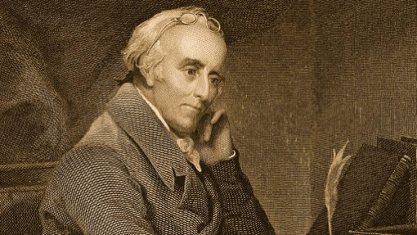
What is a Physician-Scientist?
Physicians
Care for people
Promote wellness
Diagnosis and treat illness
Observe and report trends
Scientists
Ask and answer questions
Develop hypotheses explaining our observations
Design and conduct experiments to generate facts
Advancing knowledge towards tangible solutions
Dr. Benjamin Rush

Slide 5
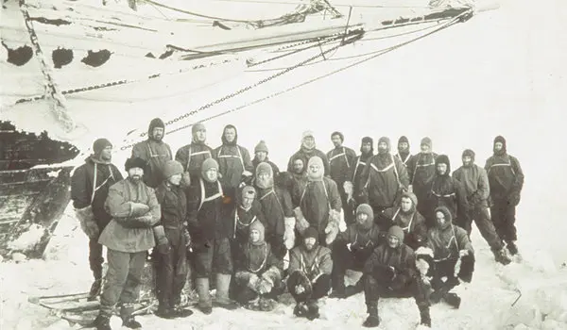
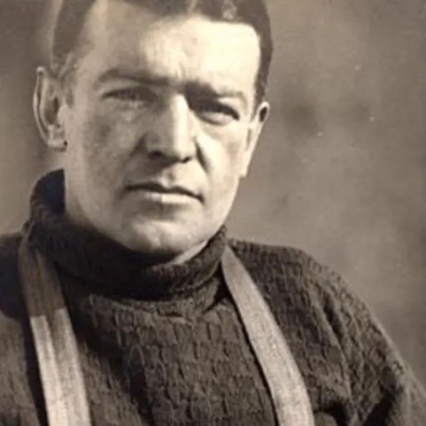
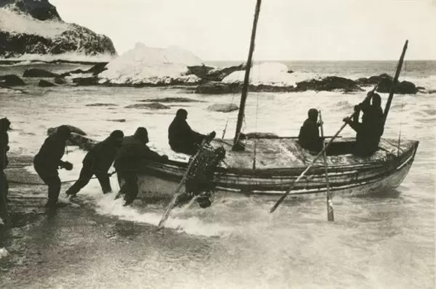
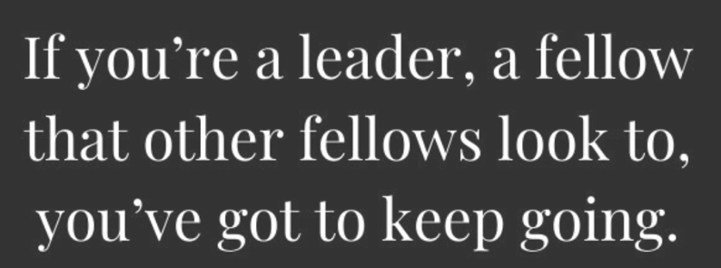
Leadership Lessons
Sir Ernest Shackleton

Slide 6
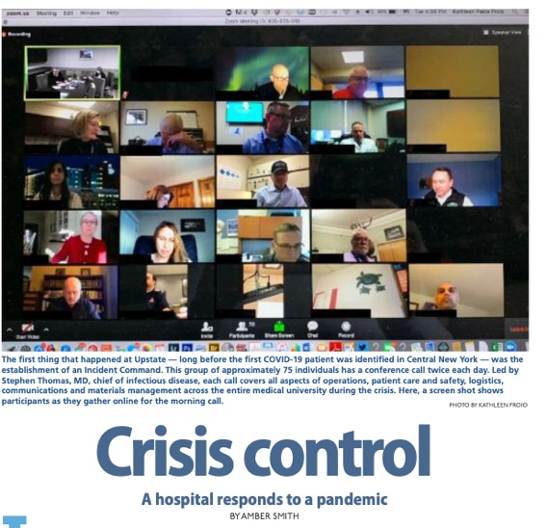
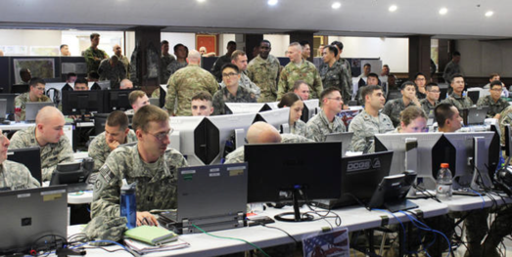
- Be Organized
Unite by mission
Organize by function
Prioritize tasks
Establish a common view
Formalize feedback

Slide 7
- Be Cross Functional
Big problems need team solutions
Isolationists have limited value
Encourage (require) dialogue
Demonstrate connectedness
Build trust
“…smart collaboration is not just a nice-to-have. It’s a strategic response to external change.”

Slide 8
- Understand Your Limits
Responsibility
Information
Resources
Authority
Know your authority
Are you communicating decisions or making them?
Be aggressive and patient
Policy
Guidance
Actions

Slide 9
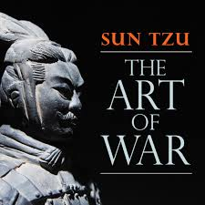
- Clearly Communicate…the 1st time
Information provided…received…understood
Especially important with a high operational tempo
Frequent changes require resilient systems
Poor communication leads to…
Inefficiency
Lost opportunities
Bad decisions
“If words of command are not clear and distinct, if orders are not thoroughly understood, the general is to blame.”

Slide 10
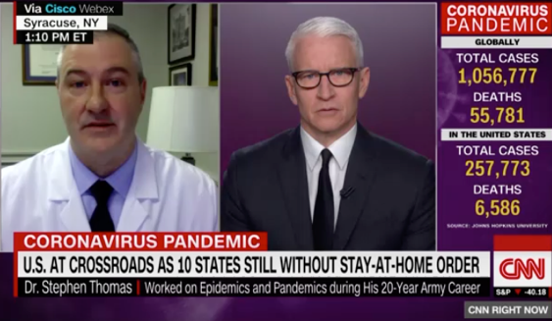
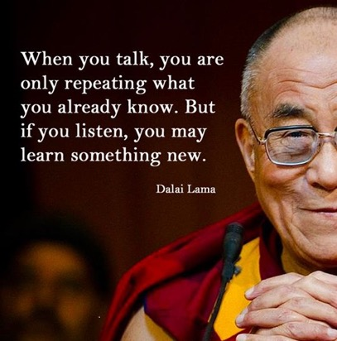
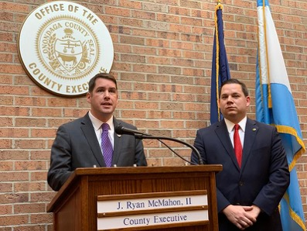
- Communicate With Intent
Know your goal
Influence behavior
Know your audience
Their context and perspective
Be disciplined
”I don’t know.”
Listen and Learn

Slide 11
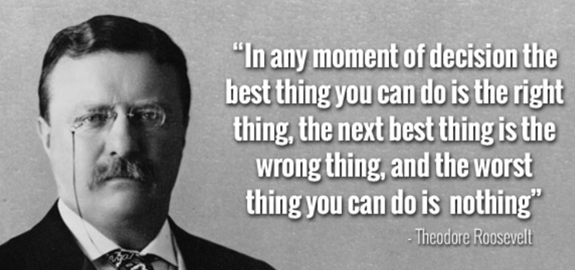
- Make Decisions
Leaders make decisions – Managers execute decisions
There is no such thing as, “All the facts…”
Timing is everything
Don’t rush, but don’t delay your decisions
Prepare to stand alone

Slide 12
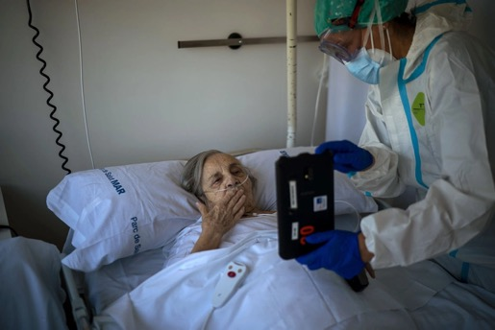
- Demonstrate Disciplined Initiative
“Simply put, disciplined initiative is when subordinates have the discipline to follow their orders and adhere to the plan until they realize their orders and the plan are no longer suitable for the situation in which they find themselves.” US Army
In times of COVID…
PPE
Triage
Testing
Rooming
Treatment
Communicating
Compassion
Cleaning

Slide 13
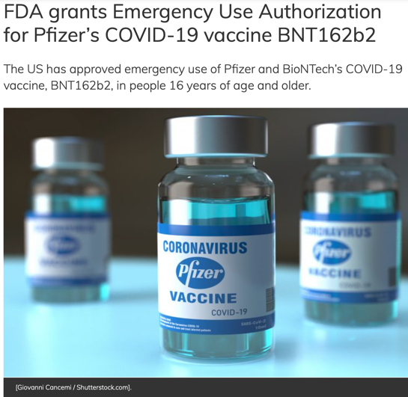
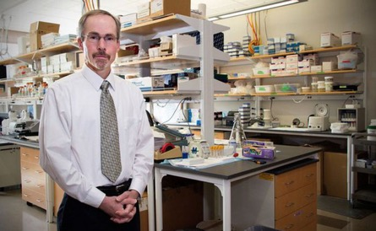
- Take Calculated Risks
Know your team
Strengths
Opportunities
Understand their comfort zone
Secure buy-in to risk taking
Check in often, reassess mood
Step on the gas
Pump the breaks

Slide 14
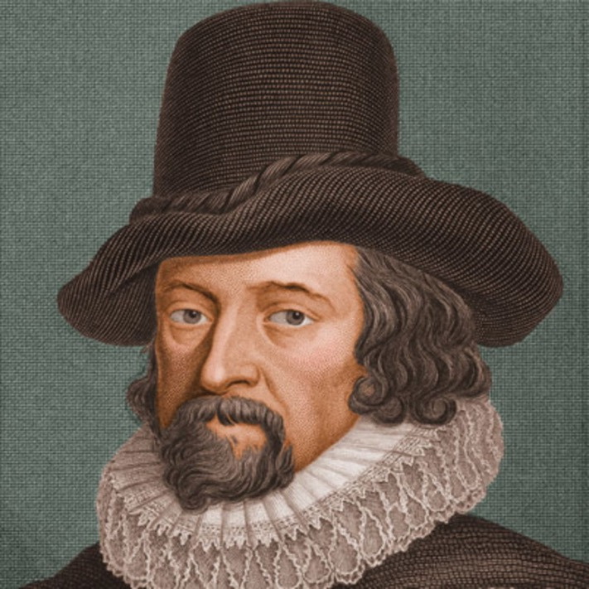
- Remember Why You Lead
"Remember well the great trust you have undertaken; you are as a continual sentinel, always to stand upon your watch to give [the King] true intelligence. If you flatter him, you betray him."
Sir Francis Bacon (1561–1626)

Slide 15
Thank you.

